Slide 1
RESTAURANT LOCATION SELECTION
IN DALLAS, TEXAS.

Slide 2
INTRODUCTION
Location Selection is the process of selecting the most appropriate and profitable location that benefits a business
Location selection implements the strategic ideas of a business by considering all the factors that needs to be evaluated
Location Selection can be significant in all sorts of business or industries, including retail, restaurants, services, wholesale and manufacturing efforts
A business location sets the tone for a business, it contributes to overall public perception of a business.

Slide 3
DATA ACQUISATION
The data used in this project was gotten from www.dallasopendata.com
The data choice was the Restaurant and Food Establishment data set
This data consists of the Location and Name of the Restaurants or Food Establishments in Dallas, Texas.
This components are valuable for this analysis. The Location data includes, Zip Codes, Lat, Long and Street Addresses.

Slide 4
DATA CLEANING
The data set comprises of 114 Columns and 40.1K (40,213 x 114) rows of Dallas Restaurant Inspection Data.
Drop Columns that will not be necessary for the project and also drop duplicate rows of the dataset.
Generating a column for the Latitude and Longitude values of each Restaurant Location.
The rows with NaN values were dropped from the data frame
Ensure that the format of the Location data in the Dataframe was accurate.

Slide 5
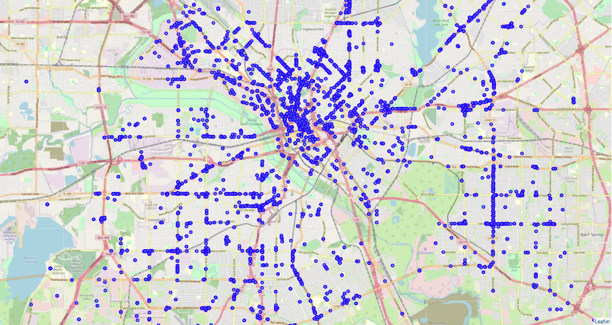
VISUALIZATION OF THE DATA POINTS

Slide 6
METHODOLOGY
Factors that we will be considering in this project for determining the most suitable location for a restaurant in Dallas, Texas.
1. Competition
2. Foot Traffic/Accessibility
Clustering is a Machine Algorithm technique that categorizes similar points together.
After implementing clustering, we analyze the clusters for the most suitable location in the clusters.

Slide 7
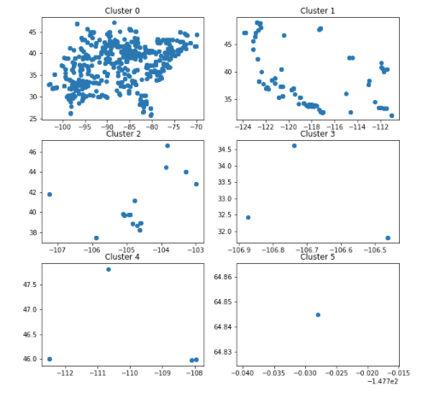
THE 6 CLUSTERS

Slide 8
FOOT TRAFFIC
Using the data in the First Cluster, we generate a new data frame with 7 Zip codes and 10 of the common locations.
This is done by running mathematical analysis using python on the data from the first Cluster.
placer.ai is the world's most advanced foot traffic analytics platform allowing anyone in the retail industry to instantly generate insights into any physical place for a deeper understanding of audiences and competition.
We use placer.ai to analyze the location with the most foot traffic in out new dataframe.

Slide 9
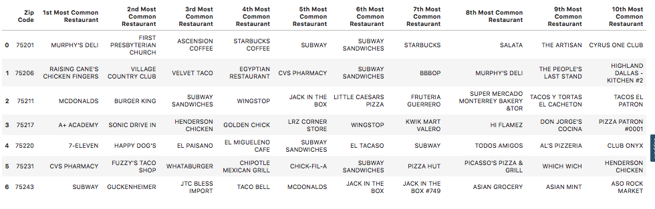
NEW DATAFRAME

Slide 10
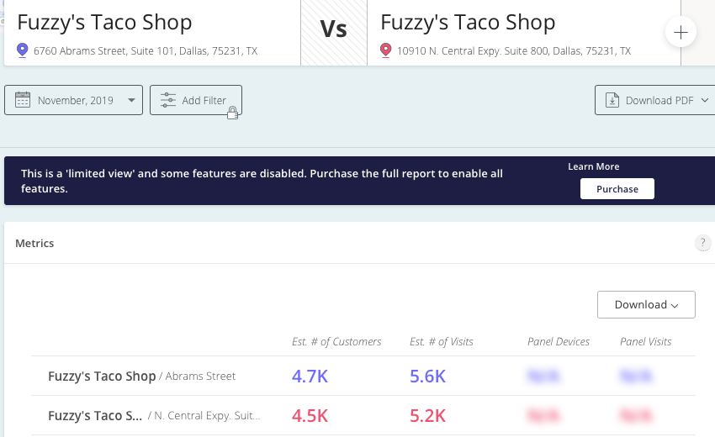
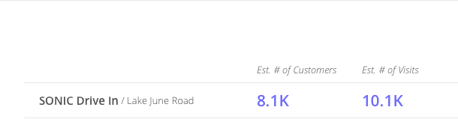
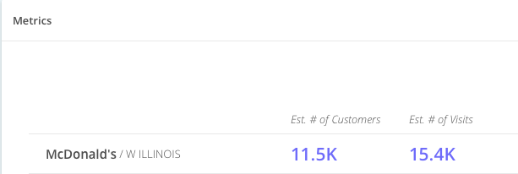
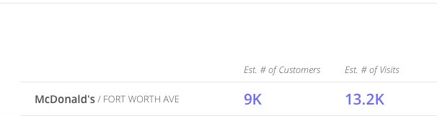
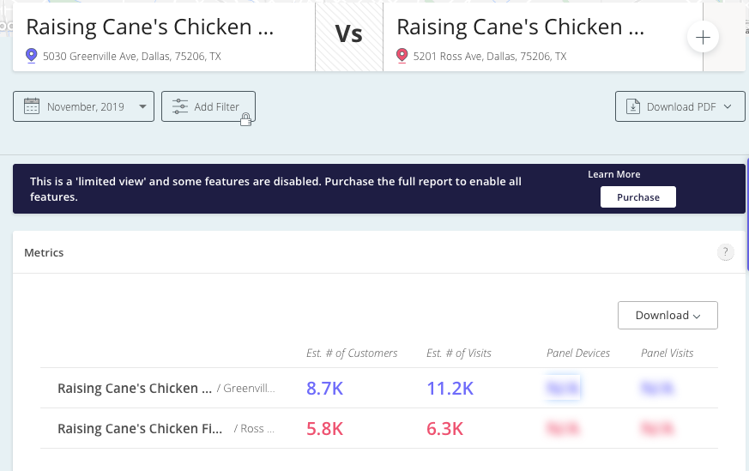
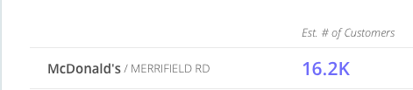
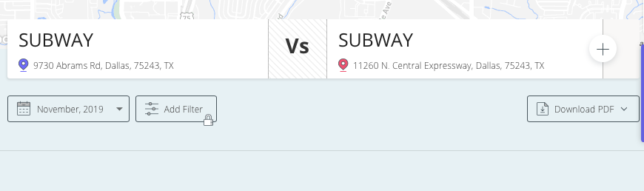
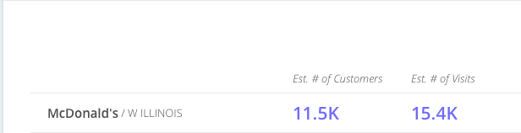
PLACER.AI FOOT TRAFFIC ANALYSIS

Slide 11
RESULT AND CONCLUSION
The Location Selection process included finding the right data for the project, preparing and cleaning the data for analysis and performing Machine Learning algorithms on the data.
Foot traffic is essential in location selection for retail or restaurants. In this project we used Placer.ai to analyze the results and choose the best location for the Restaurant. ‘
The selected choice is close to other American Fast food Chains, helping with competition, accessibility and marketing.
The accuracy of this project cannot be determined because we relied heavily on the results provided by Placer.ai. This is caused by data restriction.
The choice Location is anywhere close to the location below.

